Slide 1
Nitroxide radicals use as spin labels in proteins refine
Liu Youjia

Slide 2
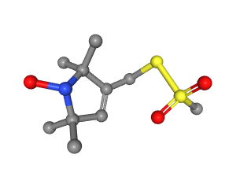


Introduction
Nitroxide Spin Labels
Proteins
MTN
Results

Slide 3
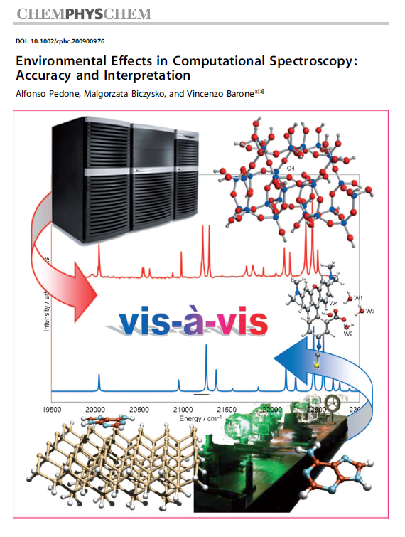
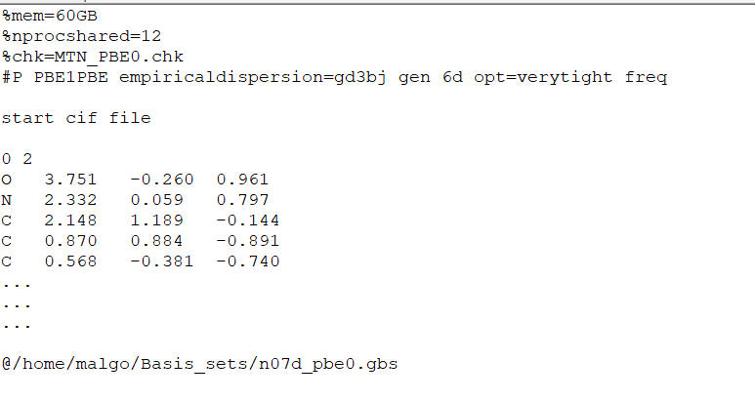
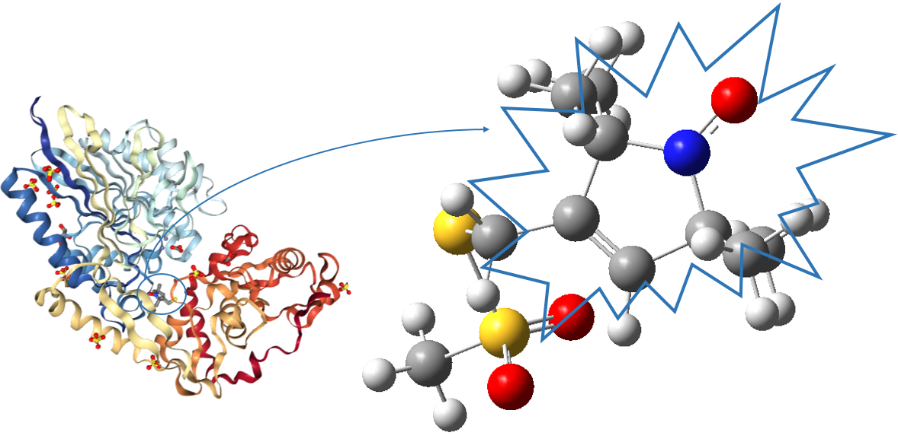
Preparation of refine – get restraint .cif file
MTN

Slide 4
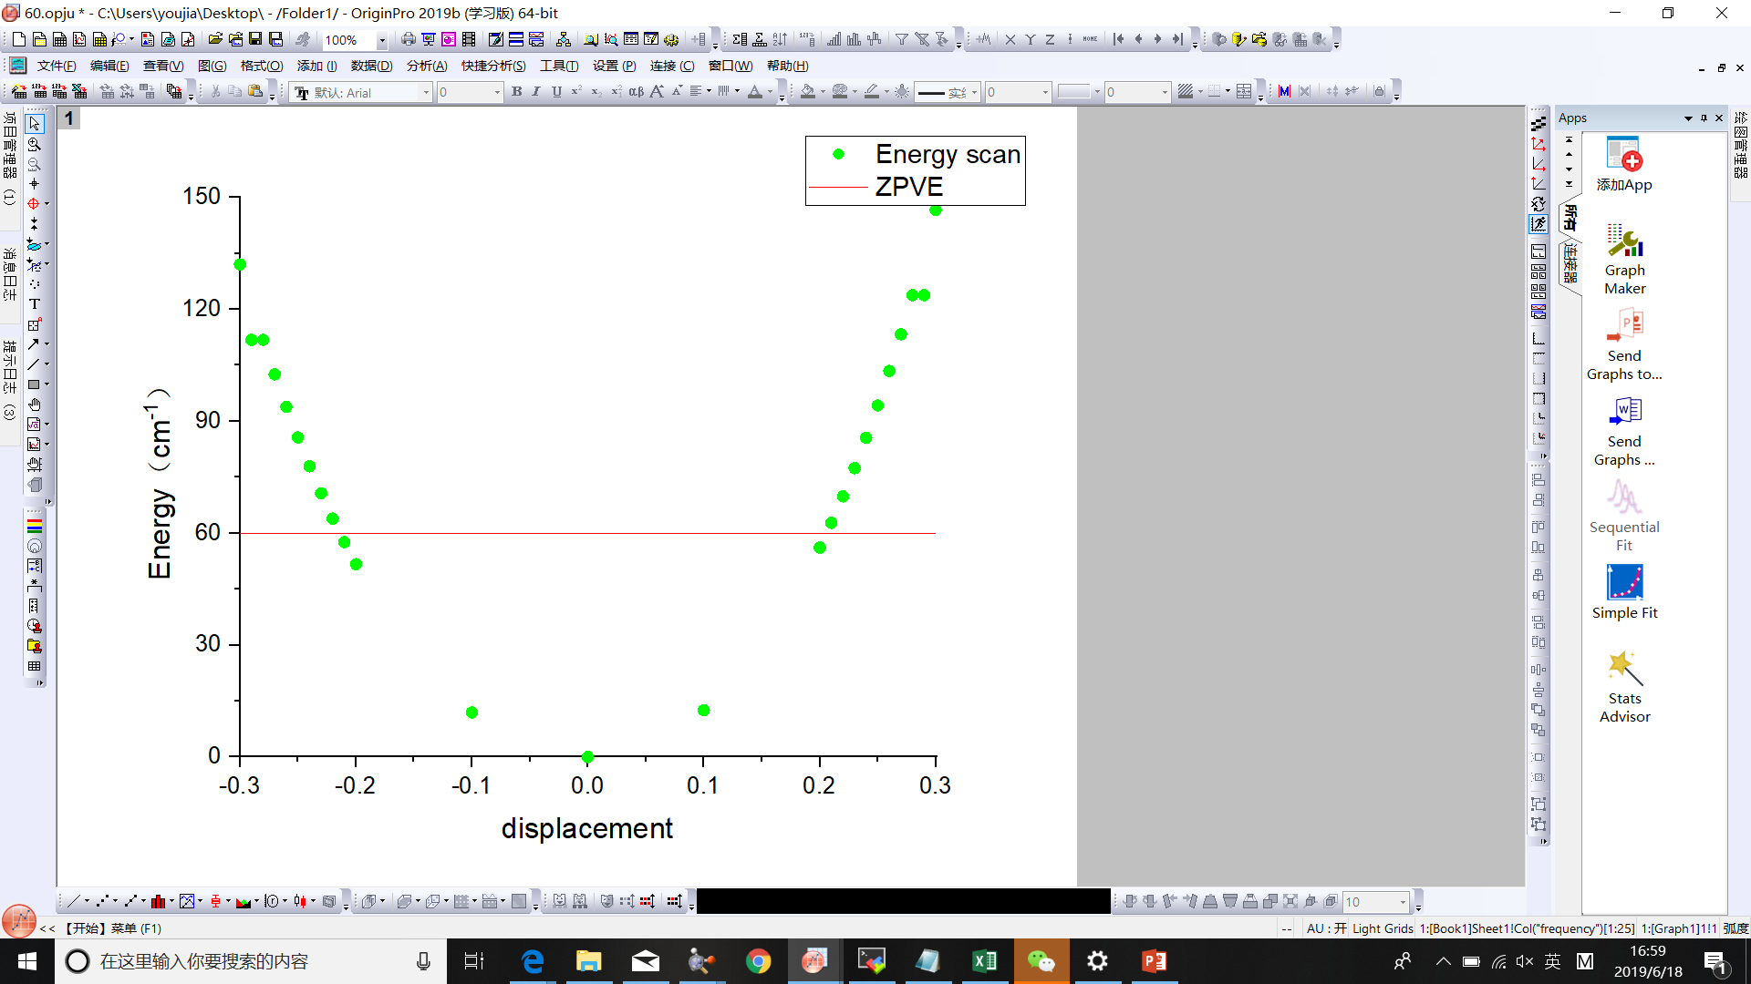
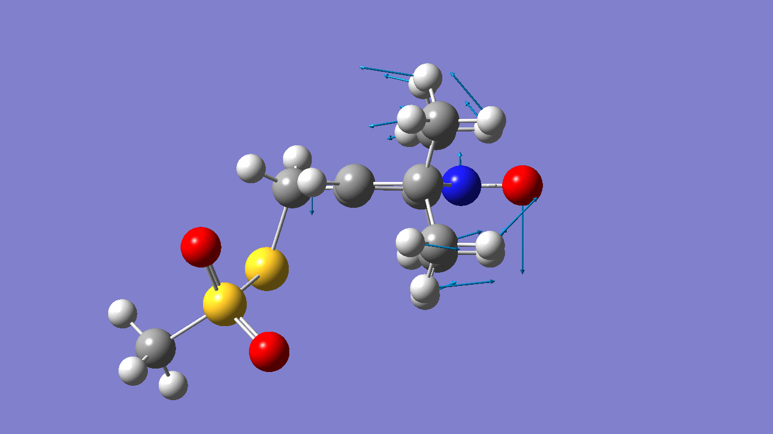
displacement | Energy (cm⁻¹)
-0.30 | 132.02
-0.29 | 111.79
-0.28 | 111.79
-0.27 | 102.53
-0.26 | 93.82
-0.25 | 85.62
-0.24 | 77.91
-0.23 | 70.69
-0.22 | 63.91
-0.21 | 57.58
-0.20 | 51.66
-0.10 | 11.94
0.00 | 0.00
0.10 | 12.53
0.20 | 56.13
0.21 | 62.73
0.22 | 69.83
0.23 | 77.42
0.24 | 85.54
0.25 | 94.21
0.26 | 103.45
0.27 | 113.29
0.28 | 123.74
0.29 | 123.74
0.30 | 146.62
Scan along out-of-plane N=O bending of MTN

Slide 5
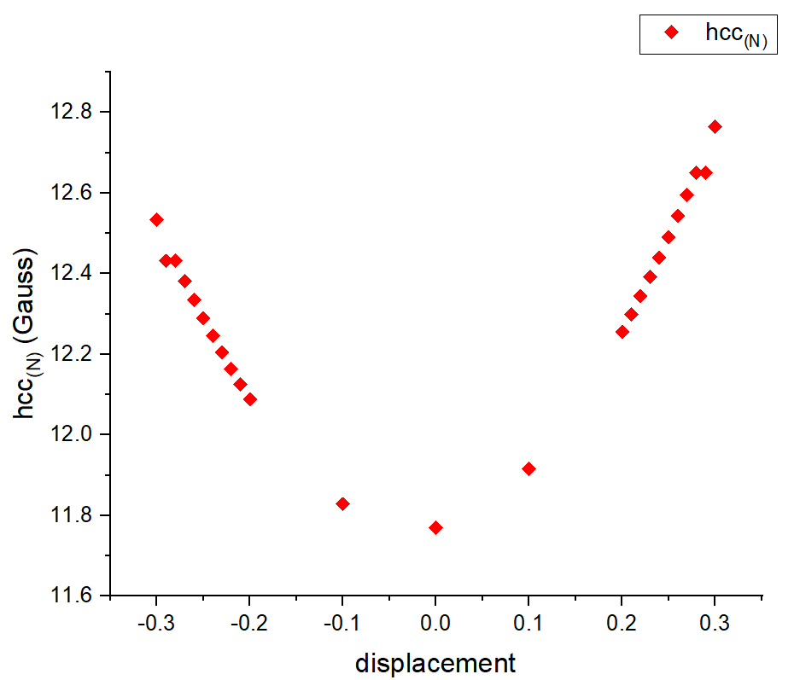
displacement | Gauss（ N ）
-0.30 | 12.53
-0.29 | 12.43
-0.28 | 12.43
-0.27 | 12.38
-0.26 | 12.34
-0.25 | 12.29
-0.24 | 12.25
-0.23 | 12.20
-0.22 | 12.16
-0.21 | 12.13
-0.20 | 12.09
-0.10 | 11.83
0.00 | 11.77
0.10 | 11.92
0.20 | 12.26
0.21 | 12.30
0.22 | 12.34
0.23 | 12.39
0.24 | 12.44
0.25 | 12.49
0.26 | 12.54
0.27 | 12.60
0.28 | 12.65
0.29 | 12.65
0.30 | 12.76
Scan along out-of-plane N=O bending of MTN

Slide 6
Steps of the whole phenix calculate
elbow.refine_geo_display
fetch_pdb
refine
ready_set
pdb_interpretation

Slide 7
UPDATE

Slide 8
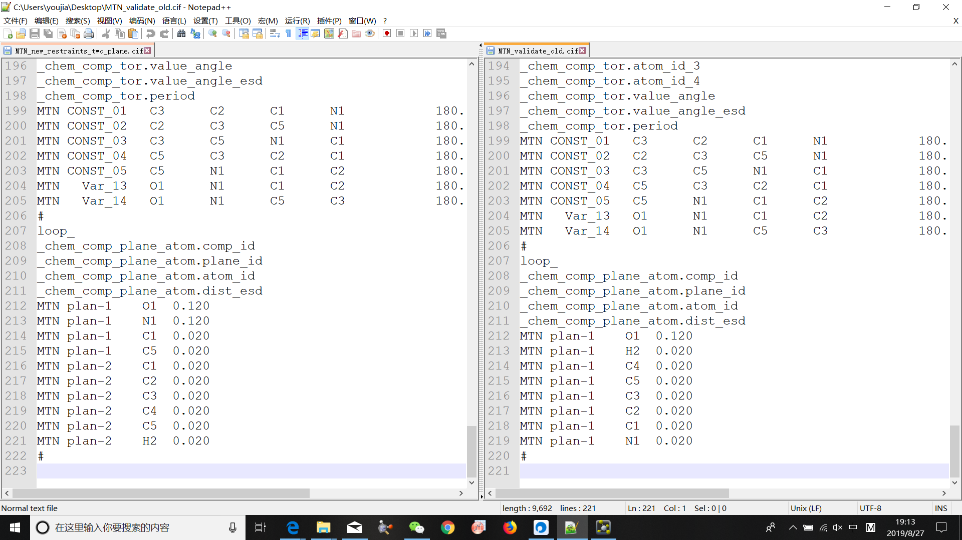
Change of new restraint file
NEW
OLD

Slide 9
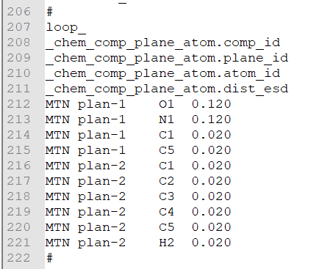
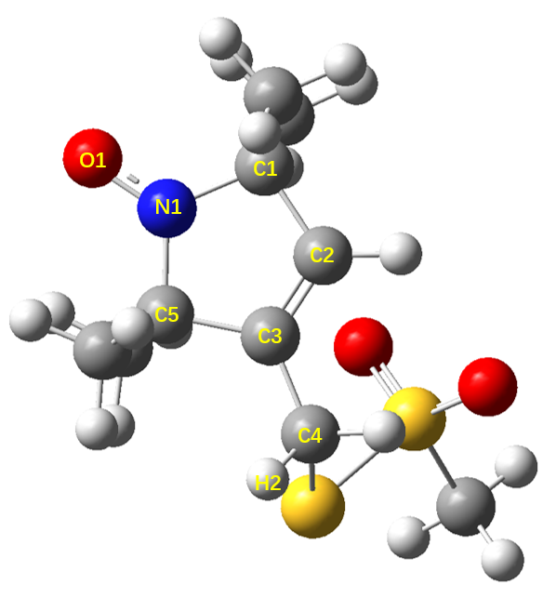
Plane-2
Plane-1
BONDS ( Å )
O1-N1 | C1-N1 | C5-N1
ANGLES ( ° )
C1-N1-C5 | C1-N1-O1 | C5-N1-O1
DIHEDRALS ( ° )
C2-C1-N1-O1 C3-C5-N1-O1

Slide 10
PDBs divided into two groups
pdb | resolution
2XGA | 2.3
2XIU | 1.5
3MPN | 2.25
3STZ | 2.5
4EK1 | 1.97
4WWL | 2.23
5BMH | 1.6
5BMI | 2.5
5G27 | 1.61
5JDT | 1
6N87 | 1.588
Divided like this because there is a gap between 1.61&1.97. Is there more basis to divide proteins?
Orange: Resolution ≤ 1.61
Grey: Resolution > 1.61

Slide 11
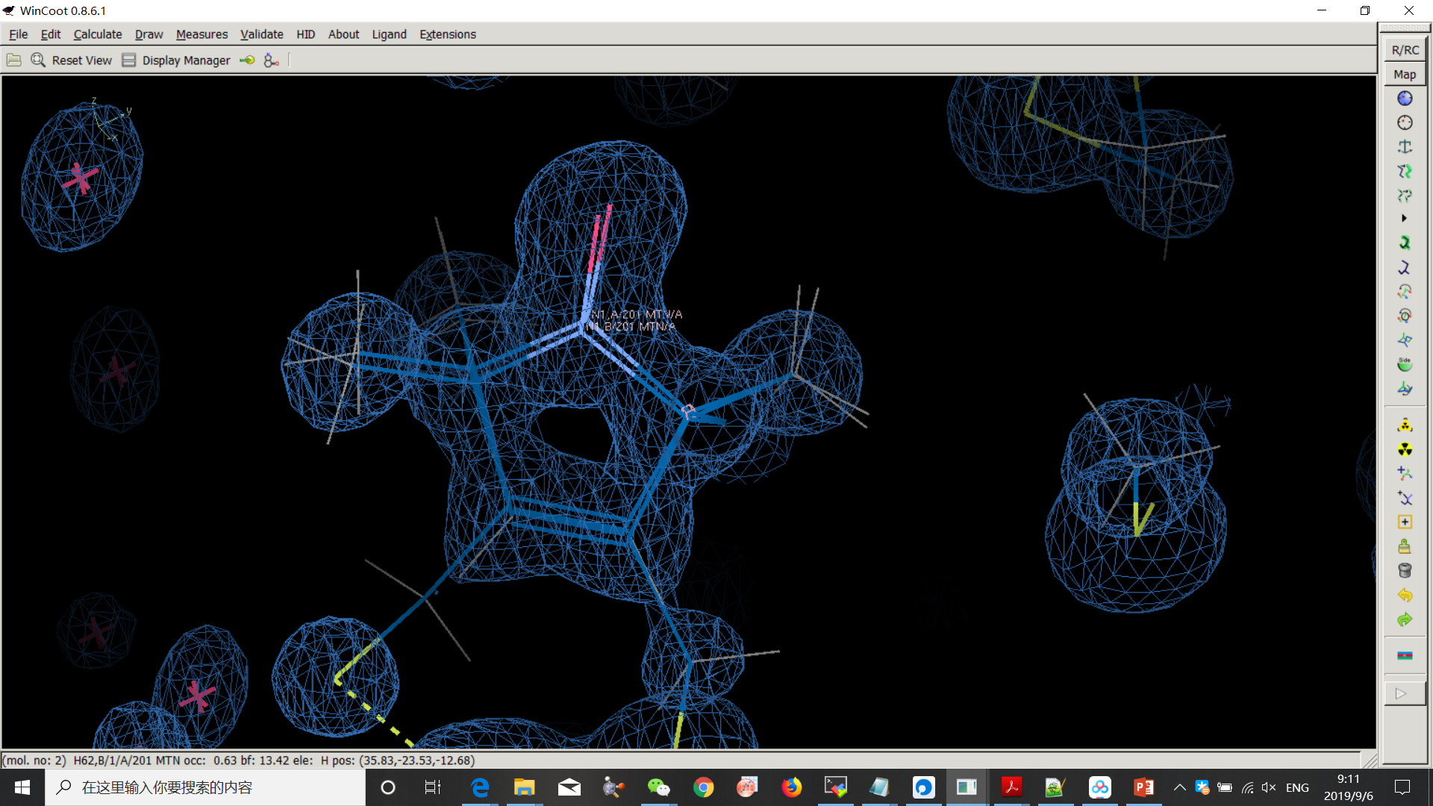
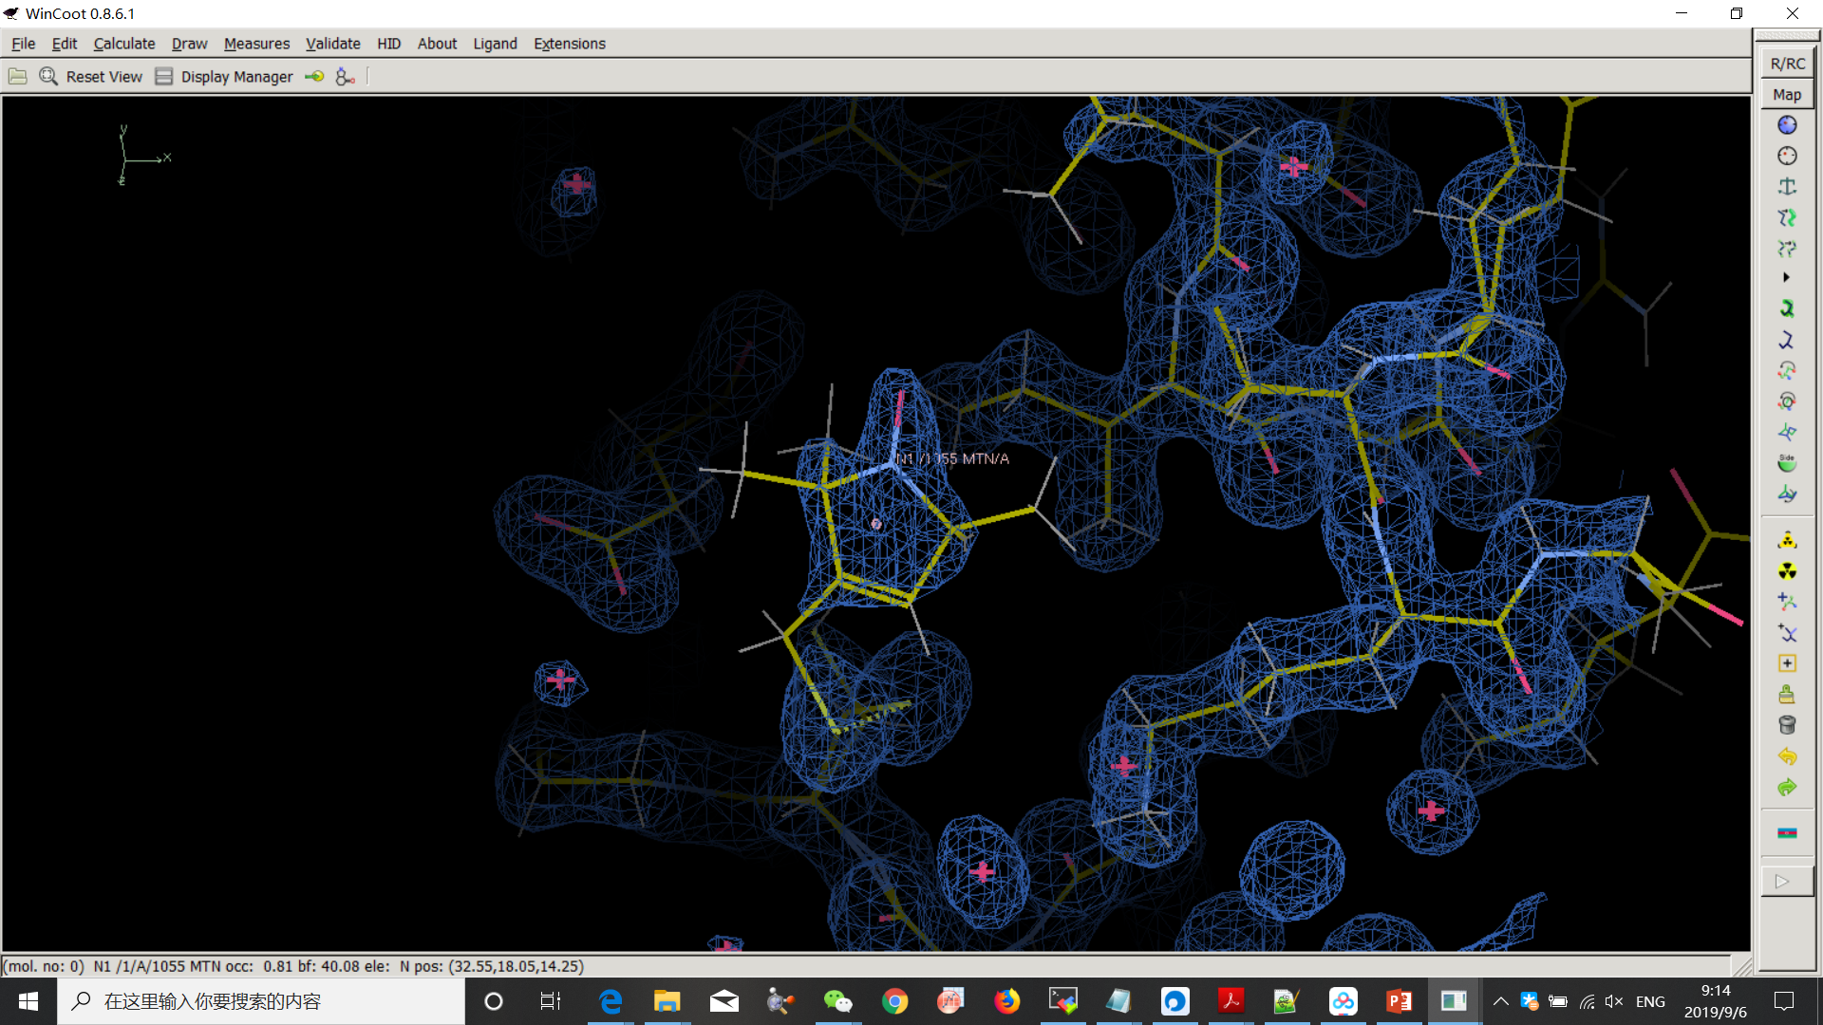
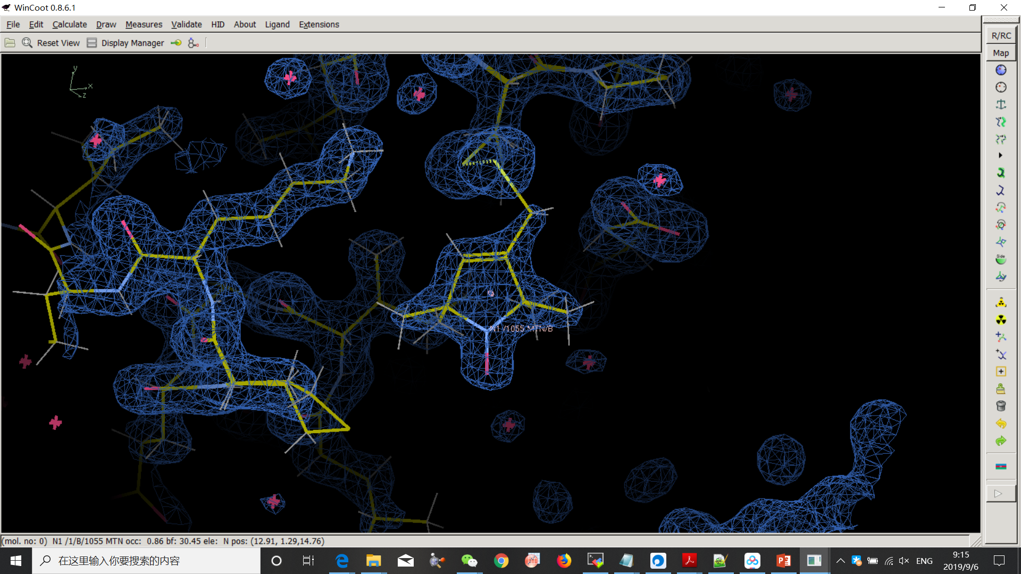
5JDT
2XIU
5JDT has two alternate location, 2XIU has two different chains
All the MTN has different data, so we need to collect all of them.

Slide 12
Resolution ≤ 1.61
2XIU-A
2XIU-B
5BMH-a-A
5BMH-b-A
5G27-a-A
5G27-b-A
5JDT-a-A
5JDT-b-A
6N87-C
Resolution > 1.61
2XGA-A
2XGA-B
3MPN-A
3STZ-C
4EK1-A504
4EK1-B504
4EK1-A505
4WWL-A
5BMI-A
-a, -b… : alternate location
-A, -B… : different chains

Slide 13
RESULTS

Slide 14
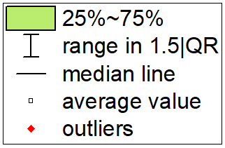
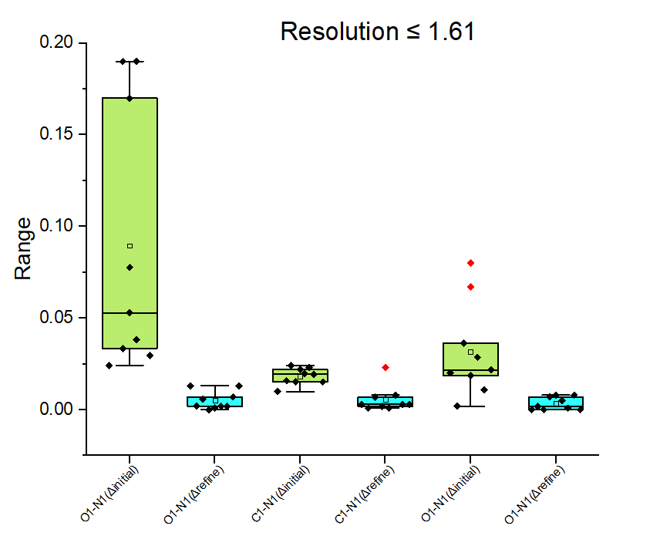
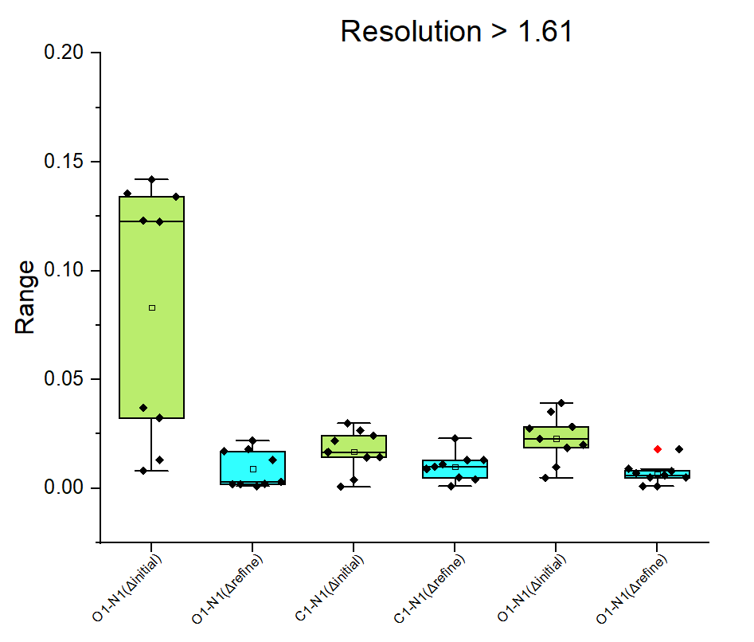
BONDS
Δ initial=ABSOLUTE ( ideal – initial )
Δ refine=ABSOLUTE ( ideal – refine )
( Å )
( Å )

Slide 15
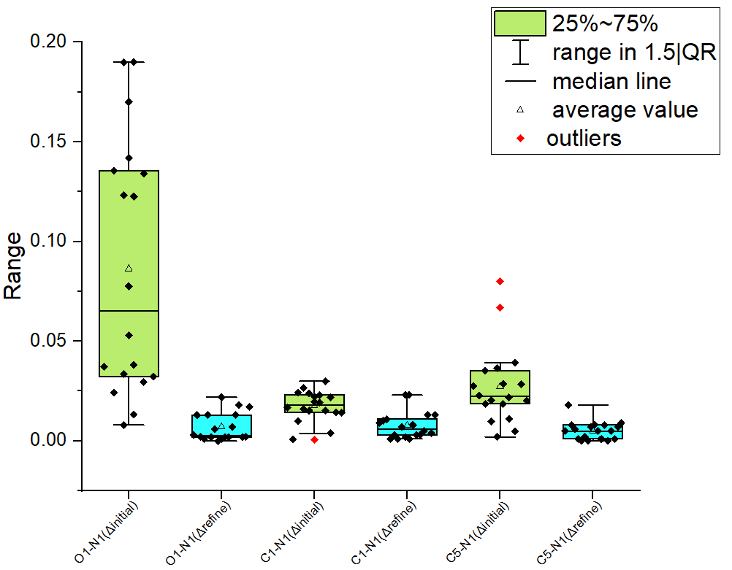
BONDS
All data in one pic
( Å )

Slide 16
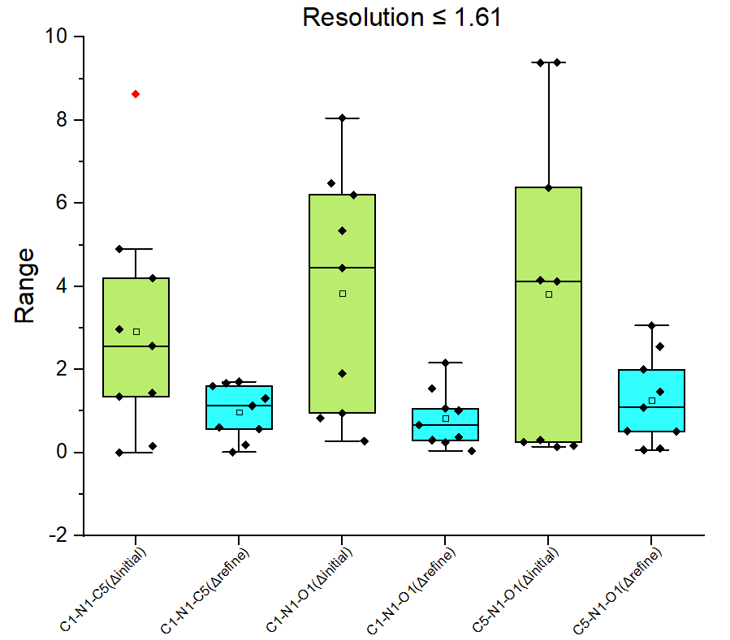
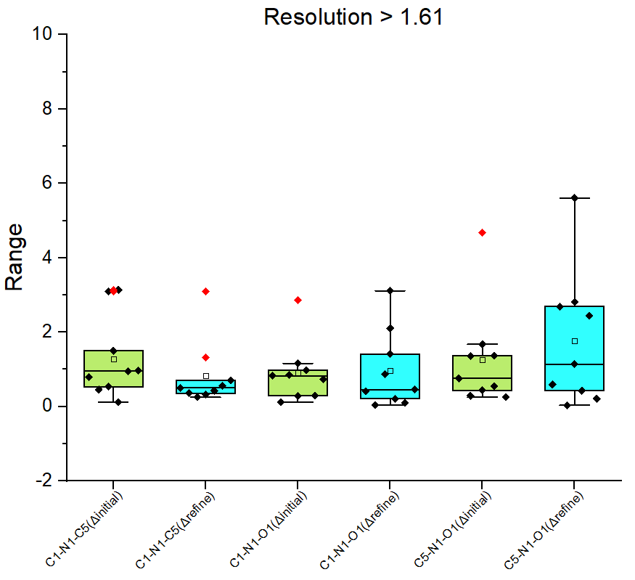
ANGLES
( °)
( °)

Slide 17
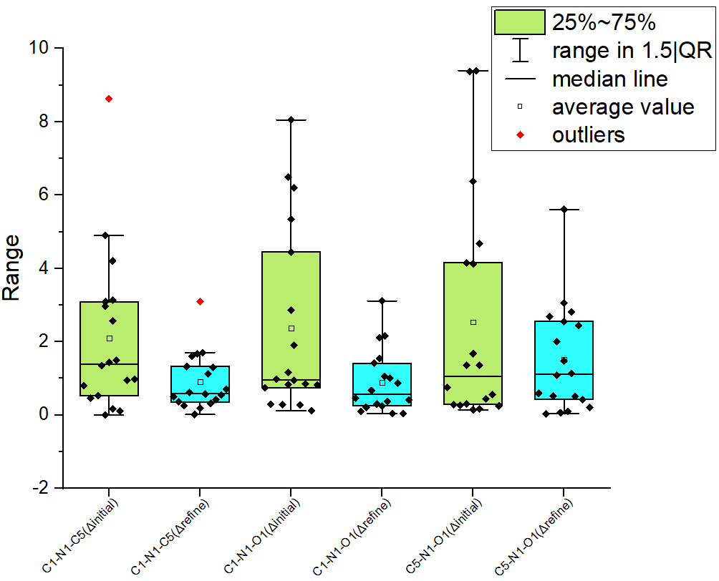
ANGLES
All data in one pic
( °)

Slide 18
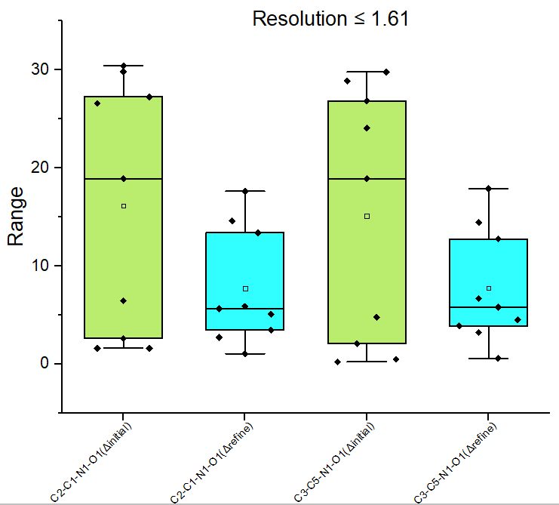
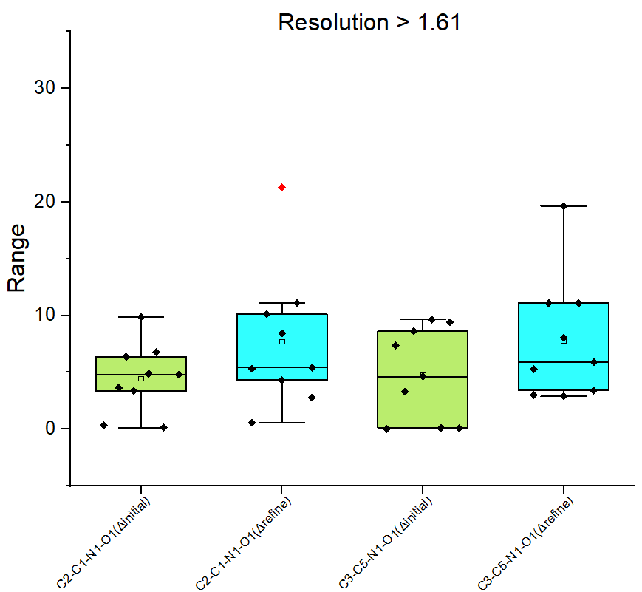
DIHEDRALS
( °)
( °)

Slide 19
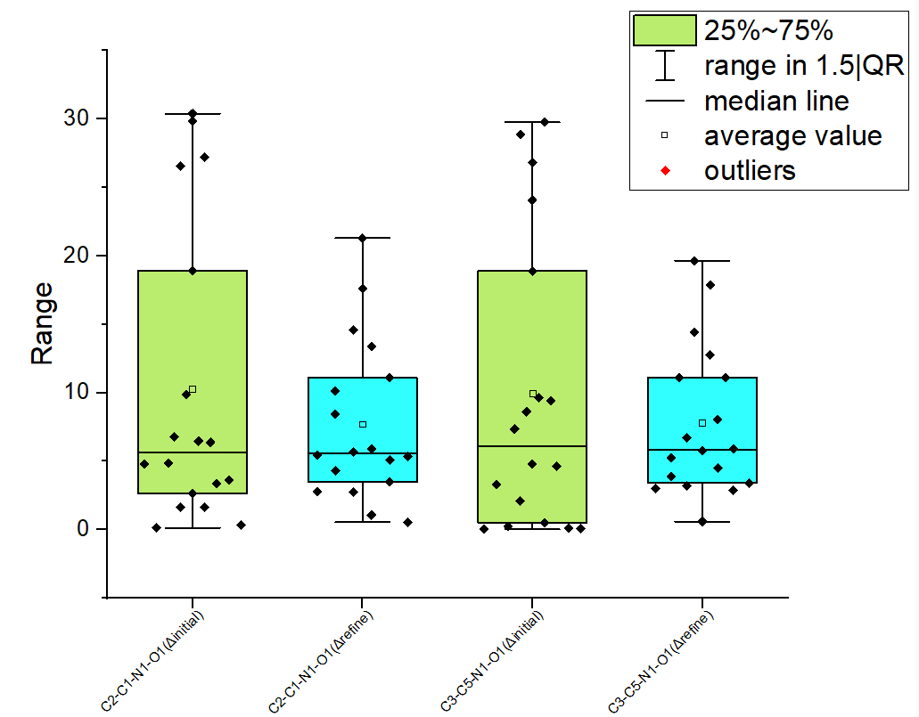
DIHEDRALS
All data in one pic
( °)

Slide 20
5G27 & 6N87 are good examples

Slide 21
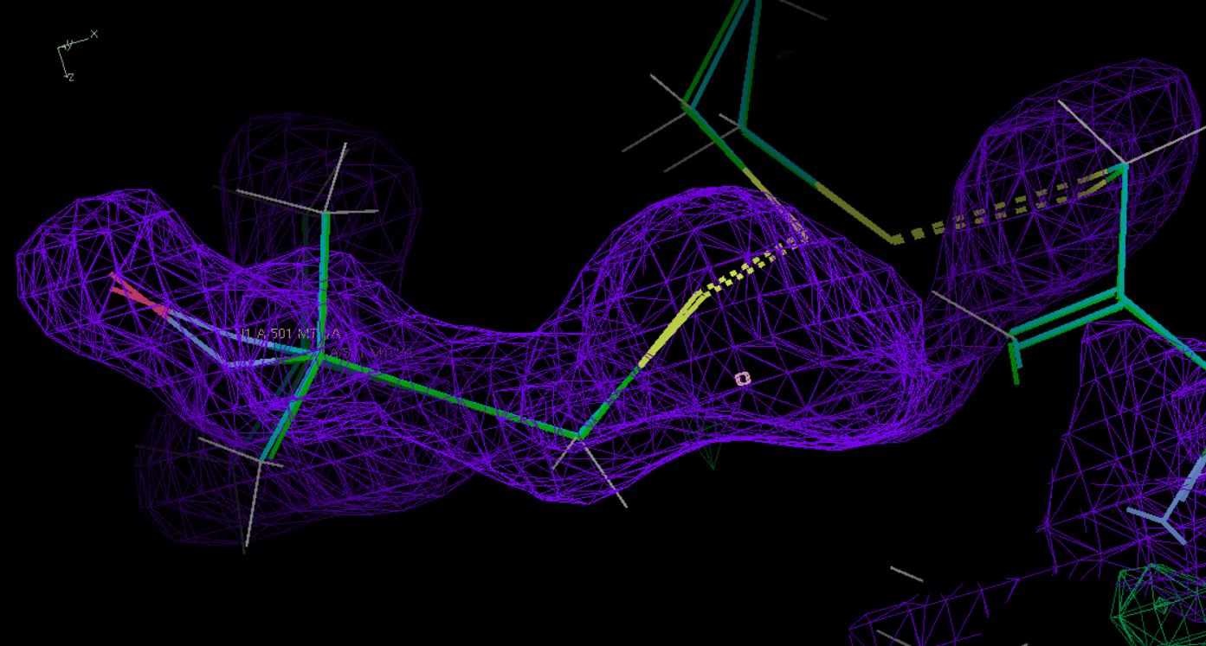
5g27 - polder OK
Refined
Initial

Slide 22
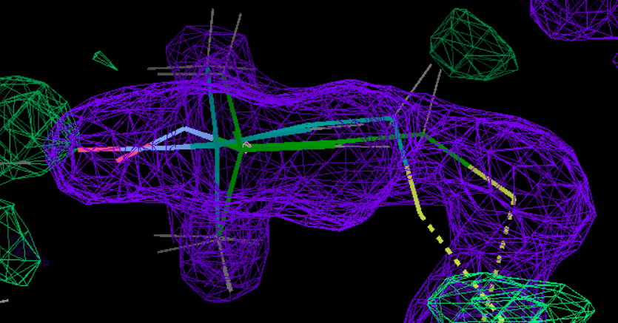
6n87 - polder OK
Initial
Refined

Slide 23
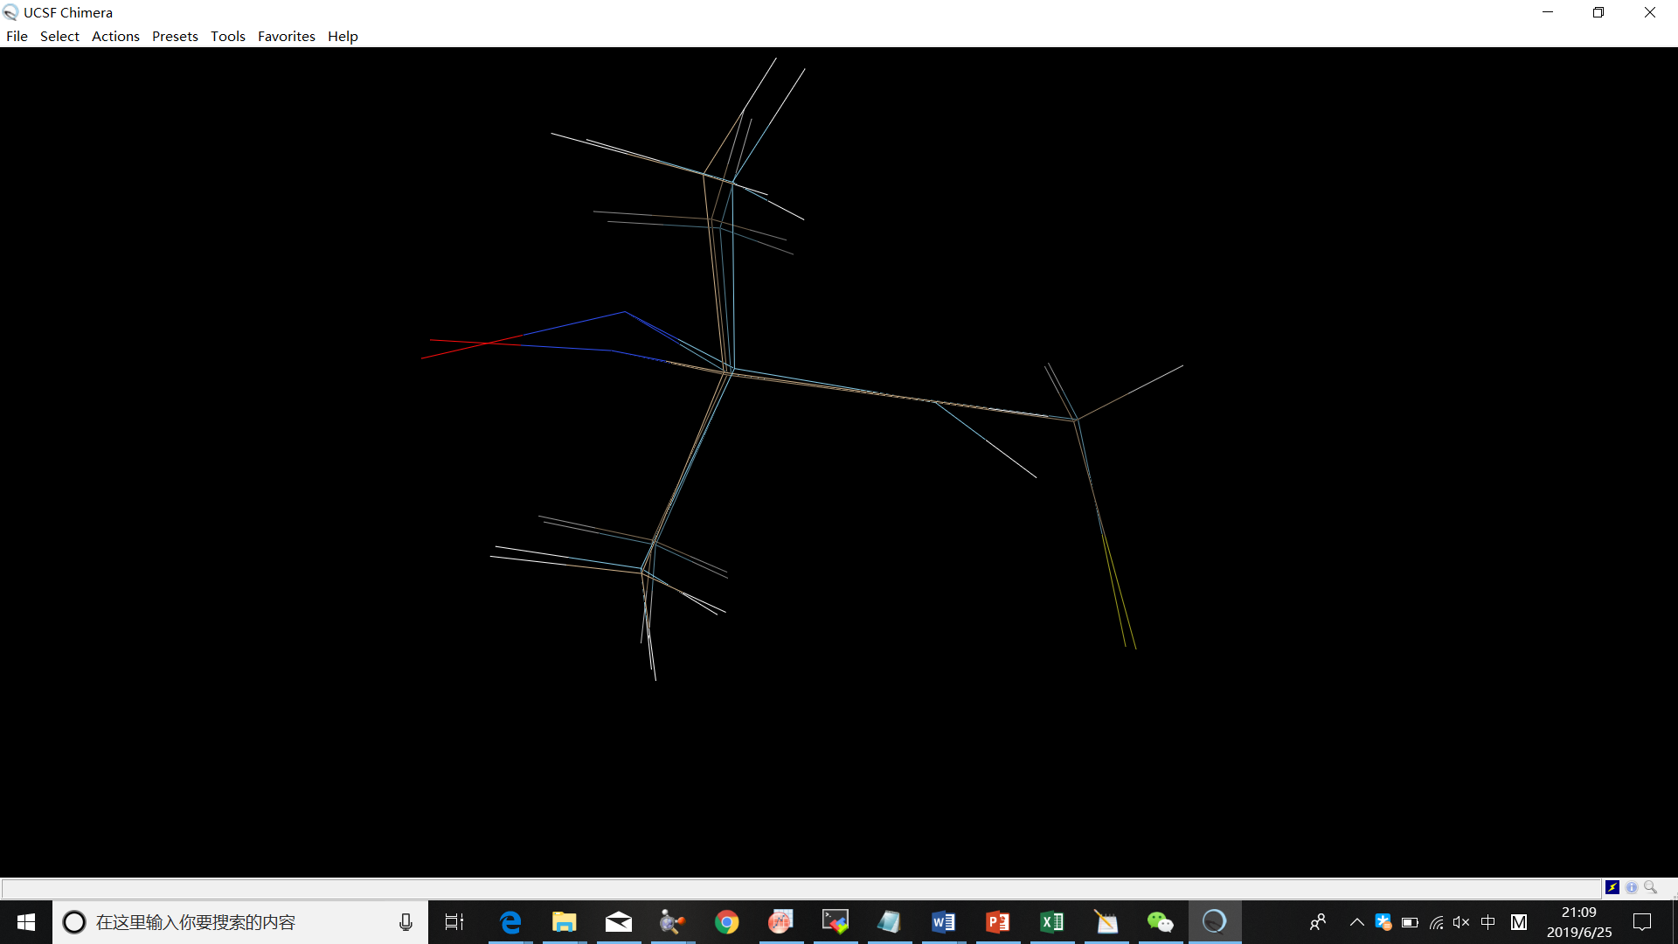
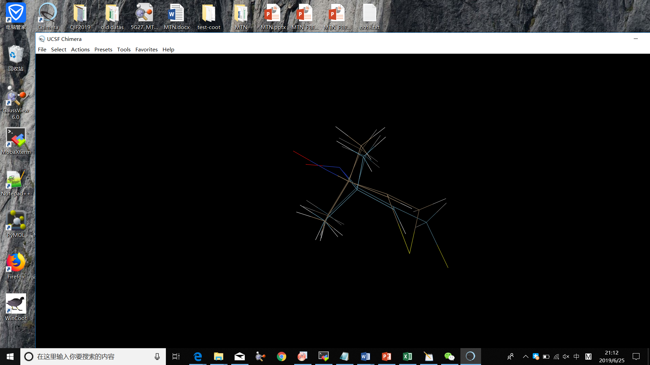
5G27 & 6N87 opened by Chimera
ready_set
5G27
6N87
refine

